Slide 1
HOTEL ROOM BOOKING
Presented By:
Aluri Charan (208W1A1268)
Kolluri Mounav (208W1A1291)
Mohammad Rizwanullah (208W1A1299)
Nagaraju Ajay Kumar Varma (208W1A12A1)
BATCH - 2

Slide 2
Introduction To react
ReactJS is a declarative, efficient, and flexible JavaScript library for building reusable UI components. It is an open-source, component-based front end library responsible only for the view layer of the application. It was created by Jordan Walke, who was a software engineer at Facebook. It was initially developed and maintained by Facebook and was later used in its products like WhatsApp & Instagram. Facebook developed ReactJS in 2011 in its newsfeed section, but it was released to the public in the month of May 2013.
A ReactJS application is made up of multiple components, each component responsible for outputting a small, reusable piece of HTML code. The components are the heart of all React applications. These Components can be nested with other components to allow complex applications to be built of simple building blocks. ReactJS uses virtual DOM based mechanism to fill data in HTML DOM. The virtual DOM works fast as it only changes individual DOM elements instead of reloading complete DOM every time.

Slide 3
HOTEL ROOM BOOKING
Our Hotel Booking React Application helps users to book hotel rooms.
They can select From and To dates and they can set filters to filter rooms as per their budget.
They can also select different types of rooms they want according to their comforts.
They can book hotels rooms worldwide in most of cities like Madrid, Austin, Paris etc.
They can signup with their mails to receive promotional news letters and best deals.
Website Hosted at : https://react-vrsec-hotels.netlify.app/hotels

Slide 4
React Features which we used
useState: The React useState Hook allows us to track state in a function component. State generally refers to data or properties that need to be tracking in an application.
props: Props are used to store data that can be accessed by the children of a React component. They are part of the concept of reusability.
useNavigate: The useNavigation is a hook which gives access to navigation object. It's useful when you cannot pass the navigation prop into the component directly, or don't want to pass it in case of a deeply nested child.
useLocation: The useLocation hook returns the location object that represents the current URL. You can think about it like a useState that returns a new location whenever the URL changes.

Slide 5
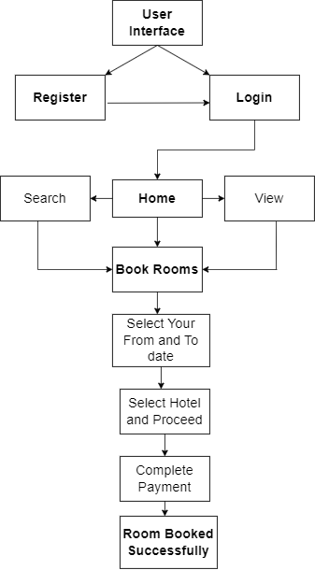
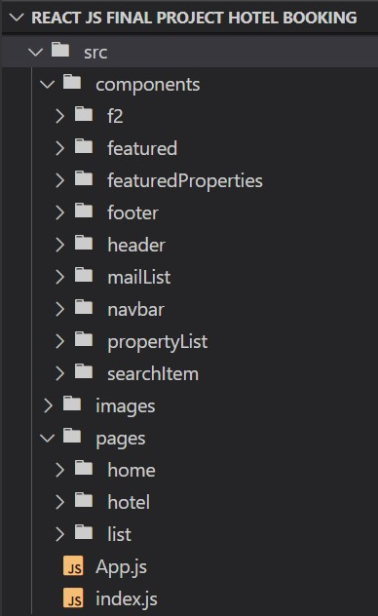
Design And Flow Diagram
Folder structure

Slide 6
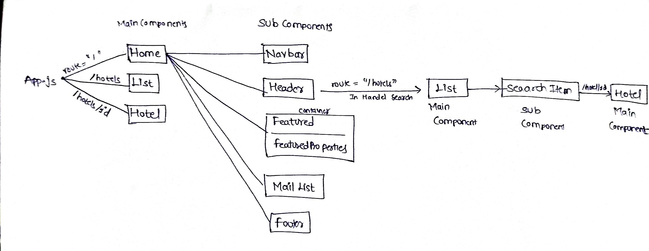
Flow in the website components

Slide 7
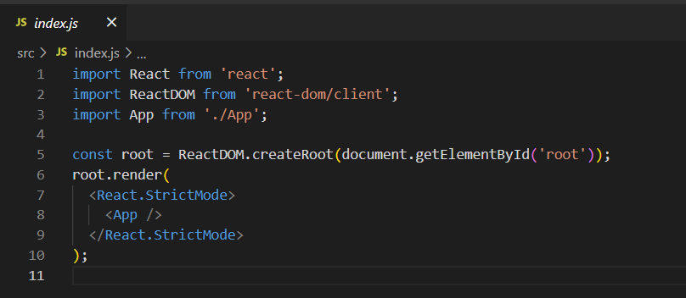
Implementation

Slide 8
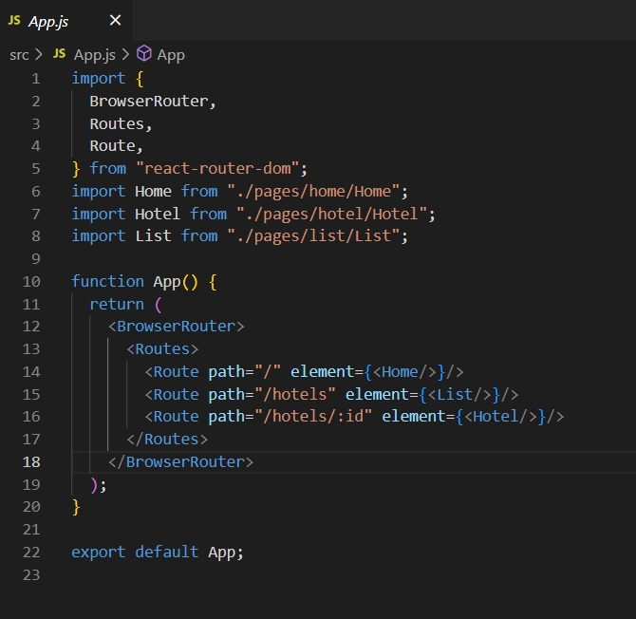
App.js

Slide 9
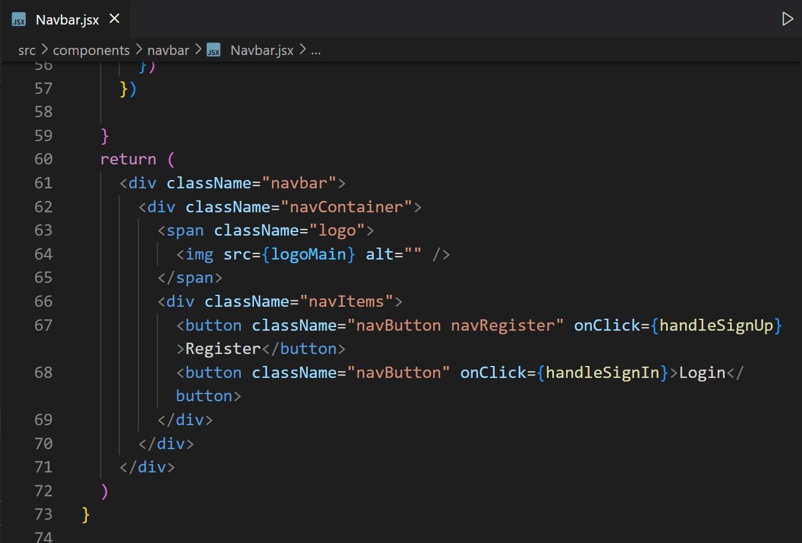
Navbar.js

Slide 10
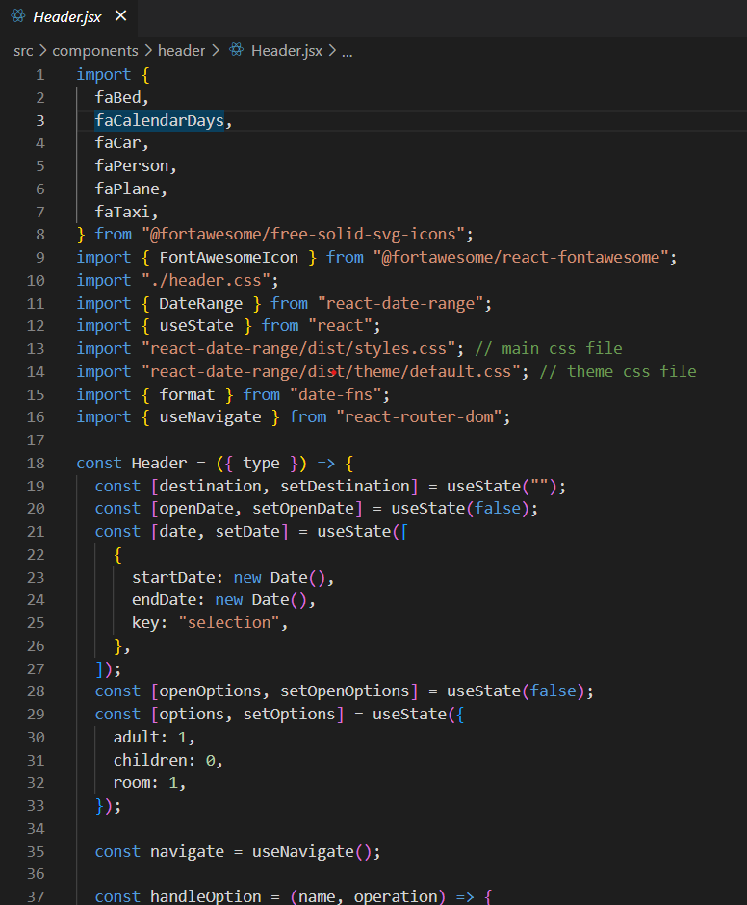
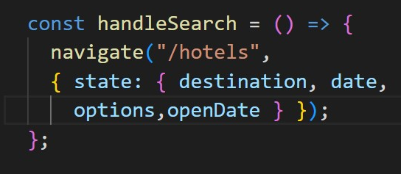
Header.js

Slide 11
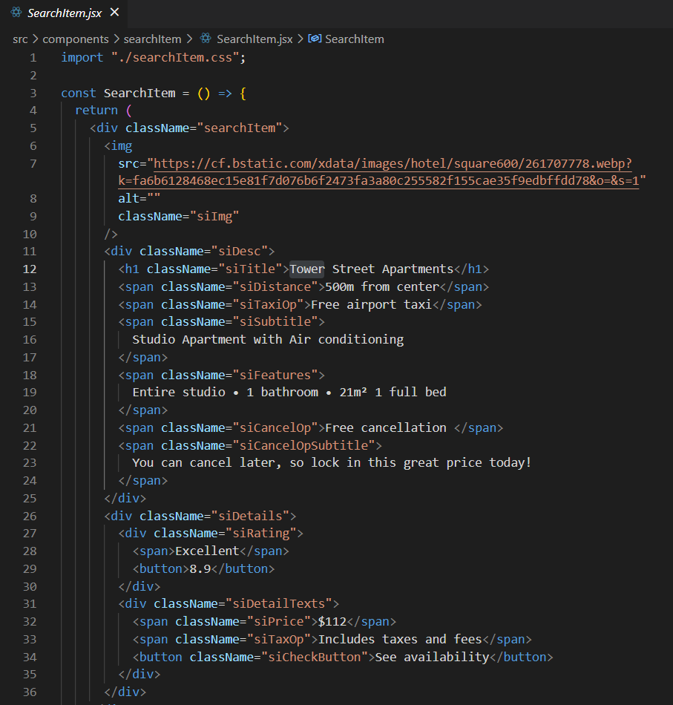
Searchiteam.js

Slide 12
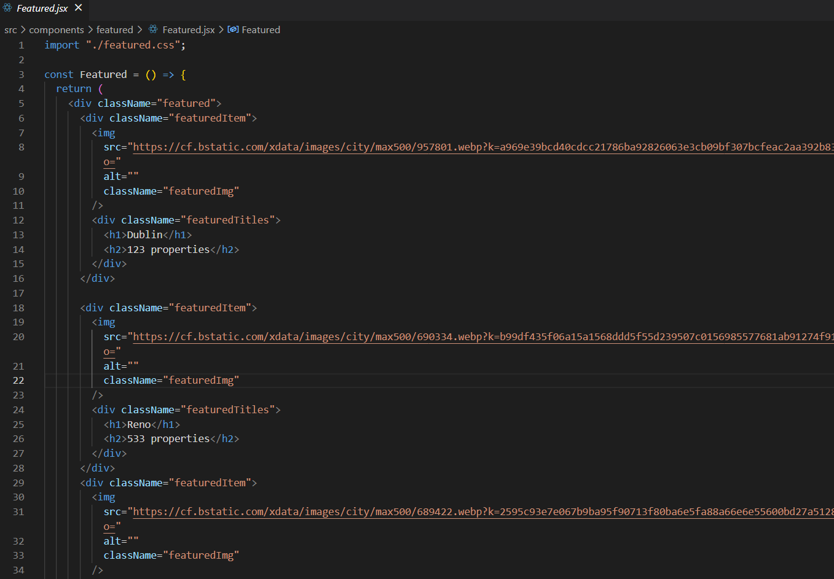
Features.js

Slide 13
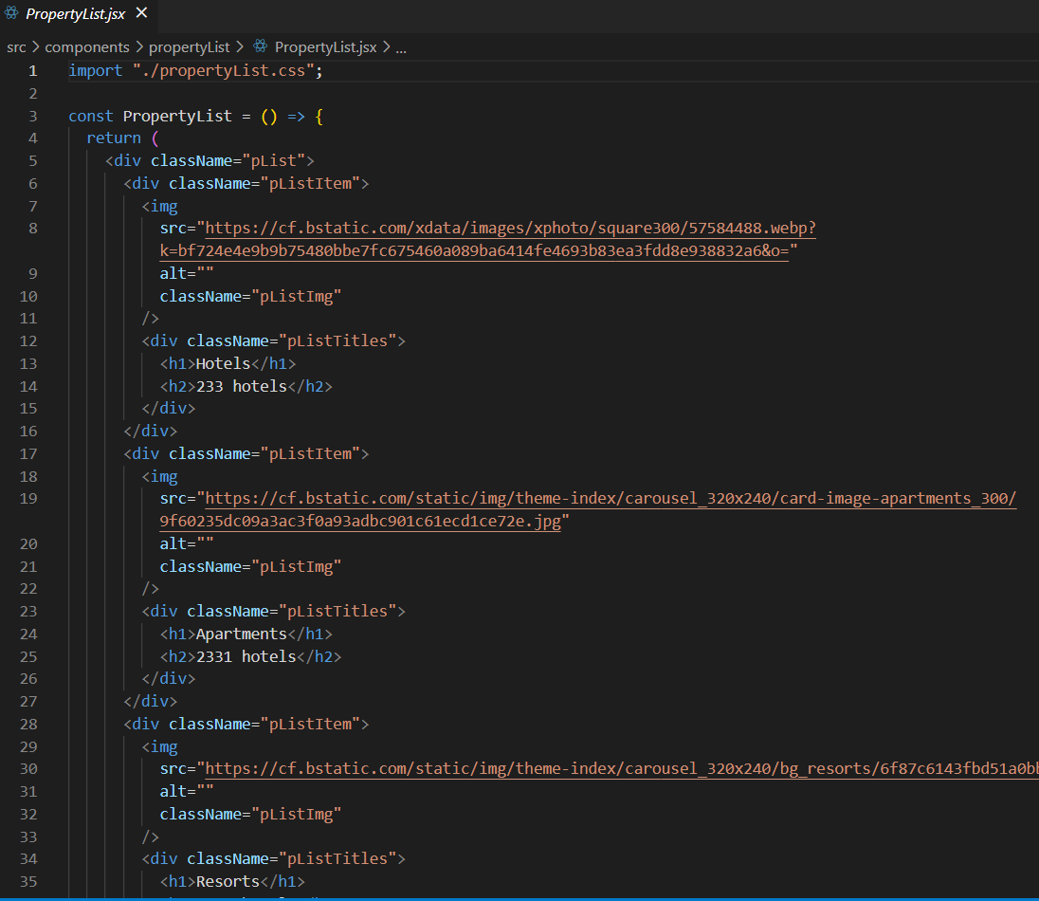
Propertylist.js

Slide 14
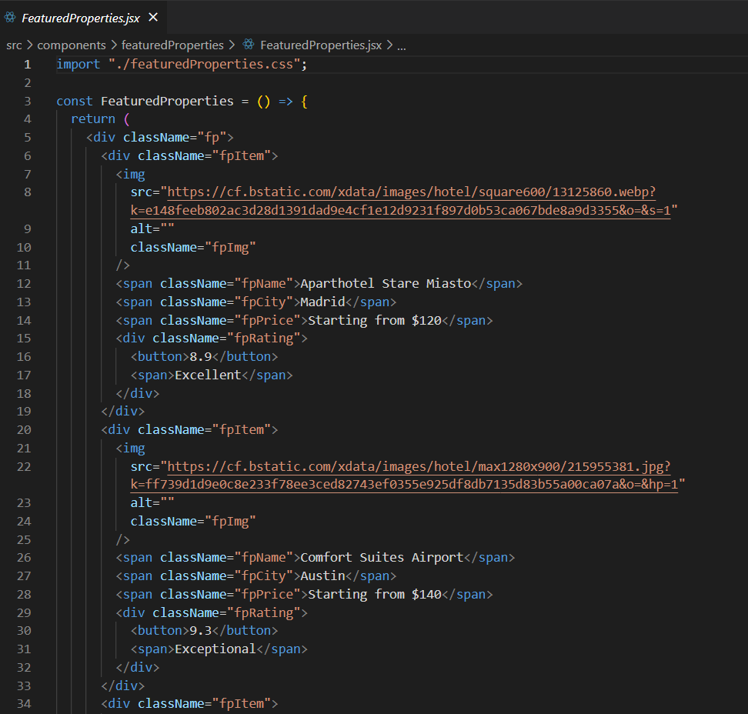
FeaturedProperties.js

Slide 15
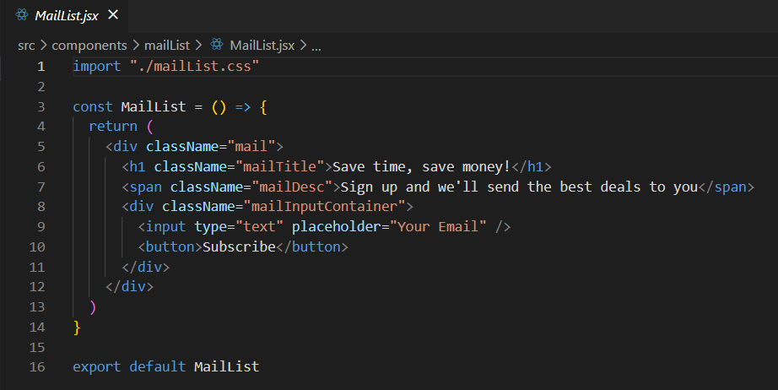
MailList.js

Slide 16
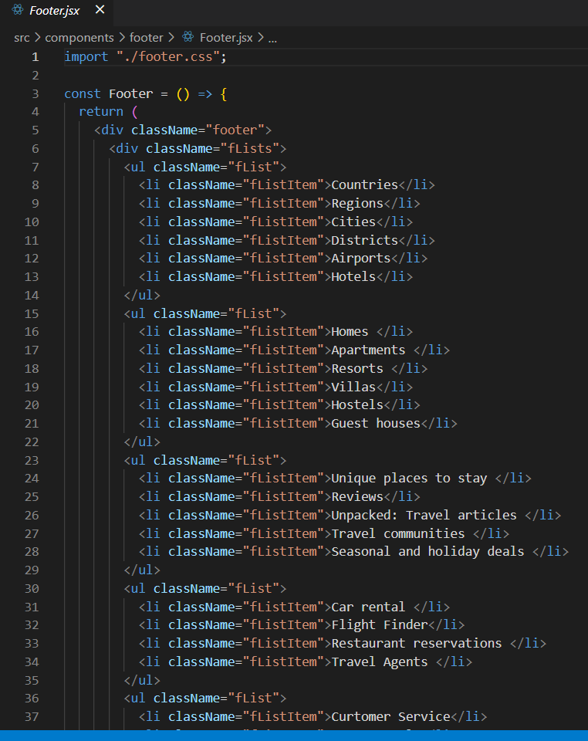
Footer.js

Slide 17
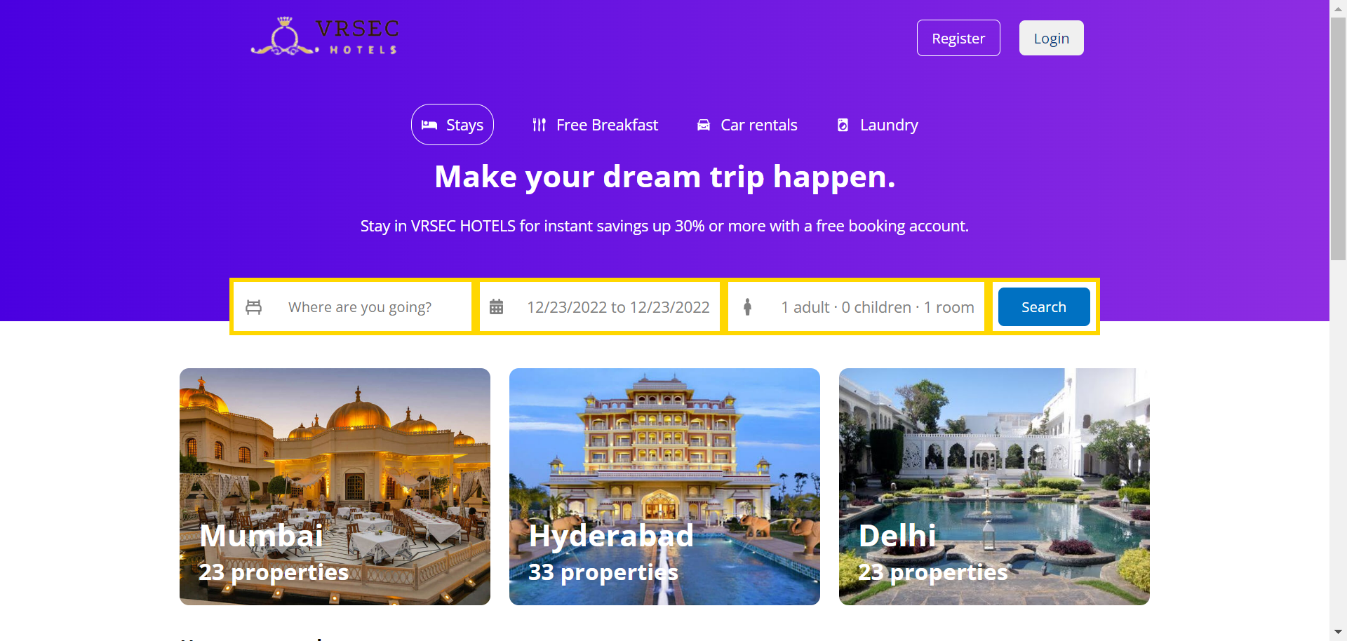
React App USER Interface

Slide 18
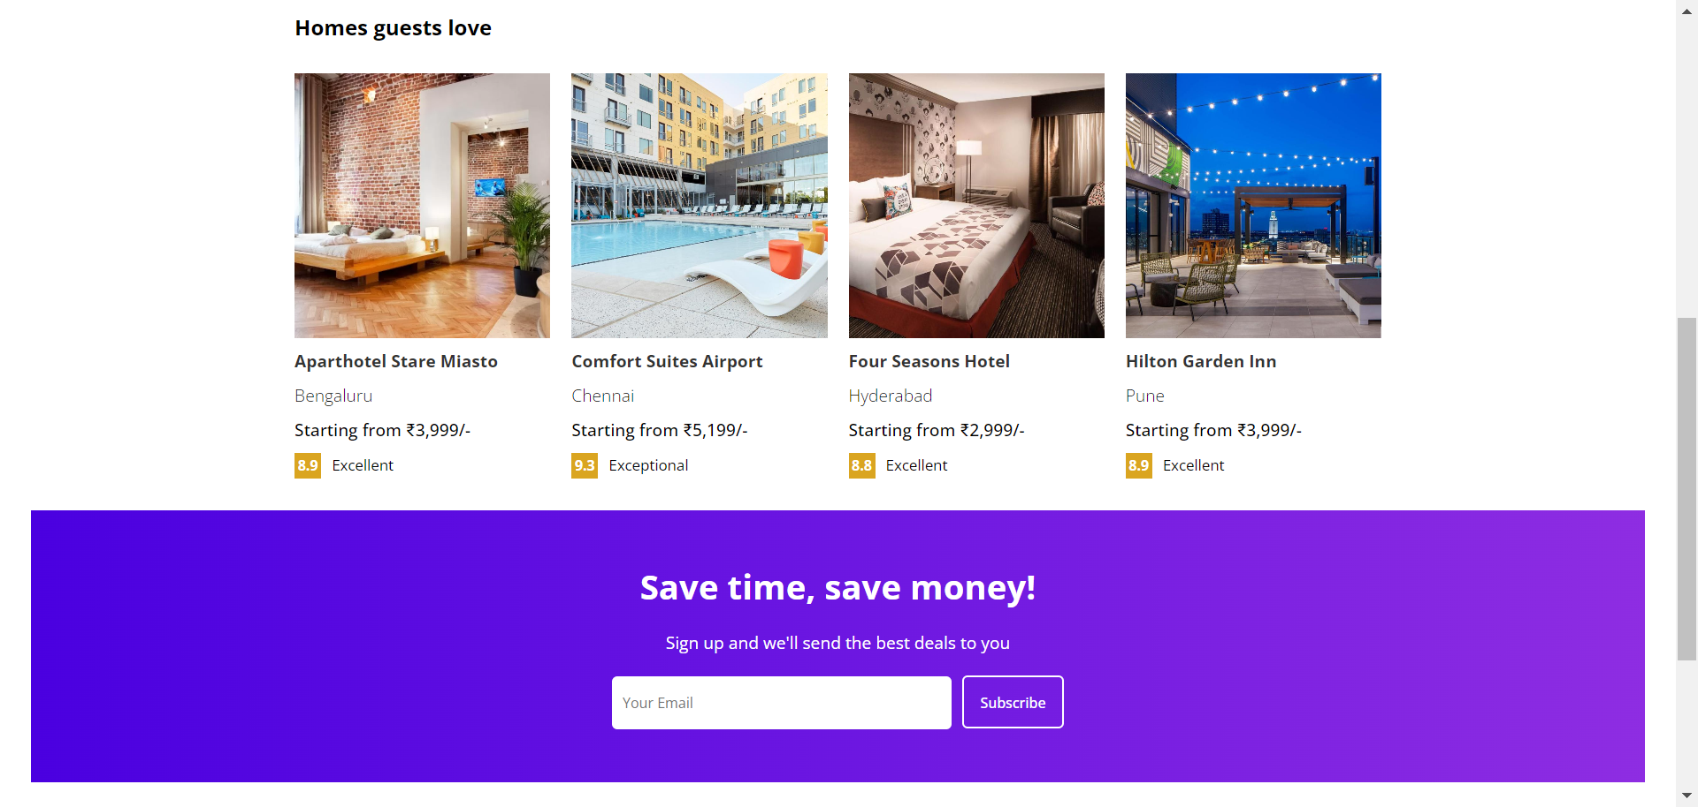

Slide 19
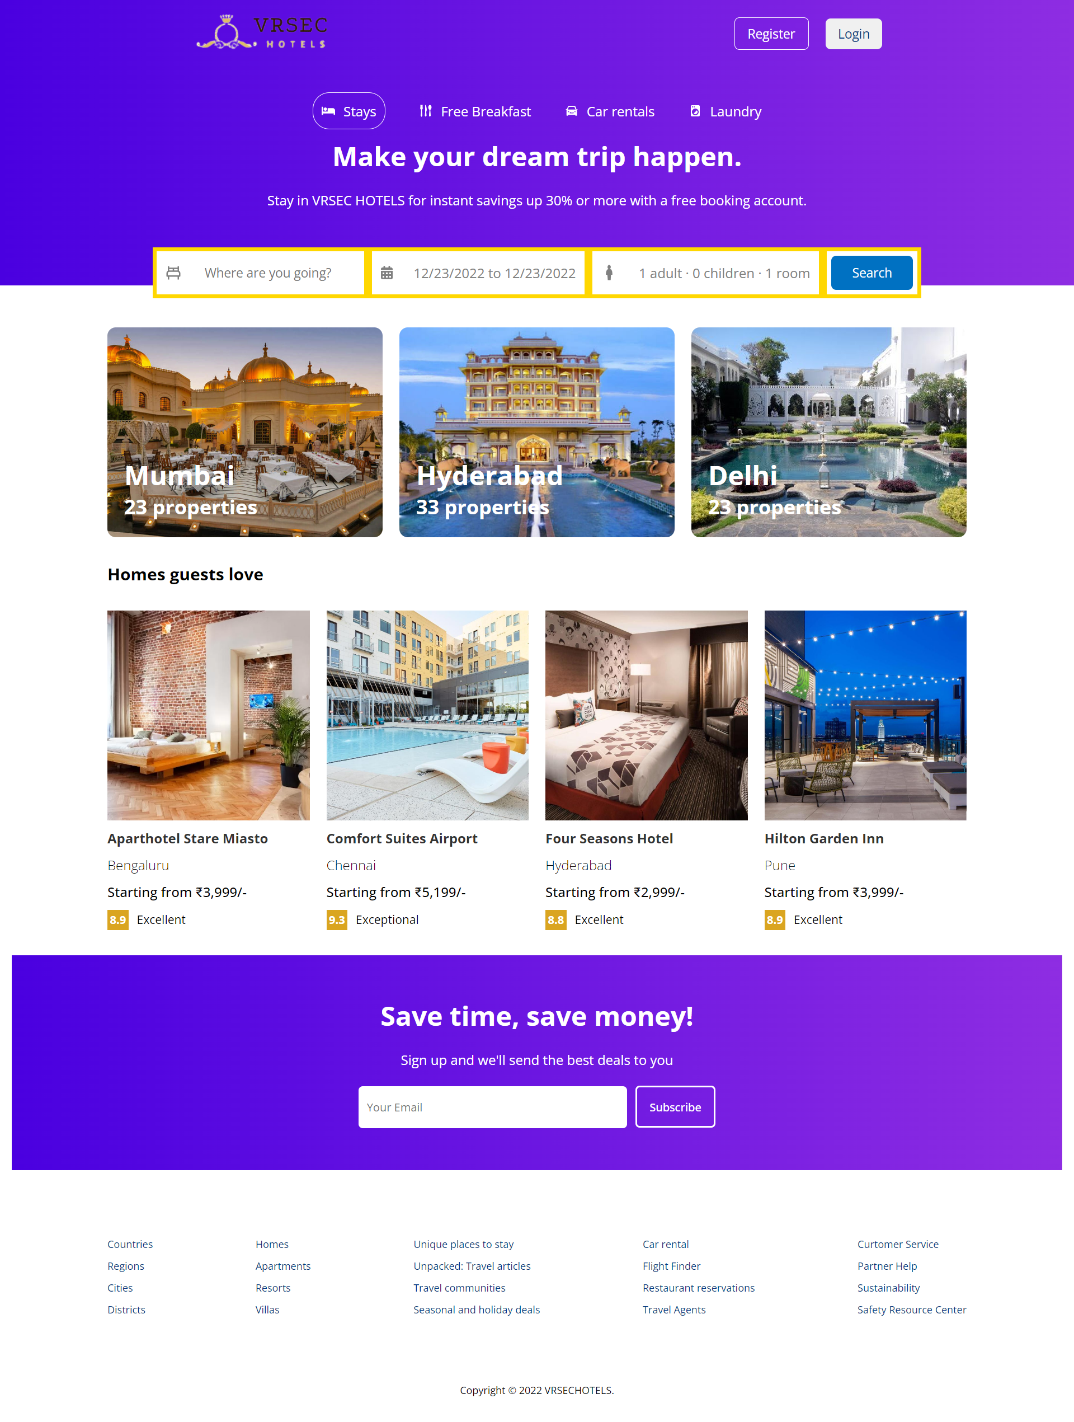
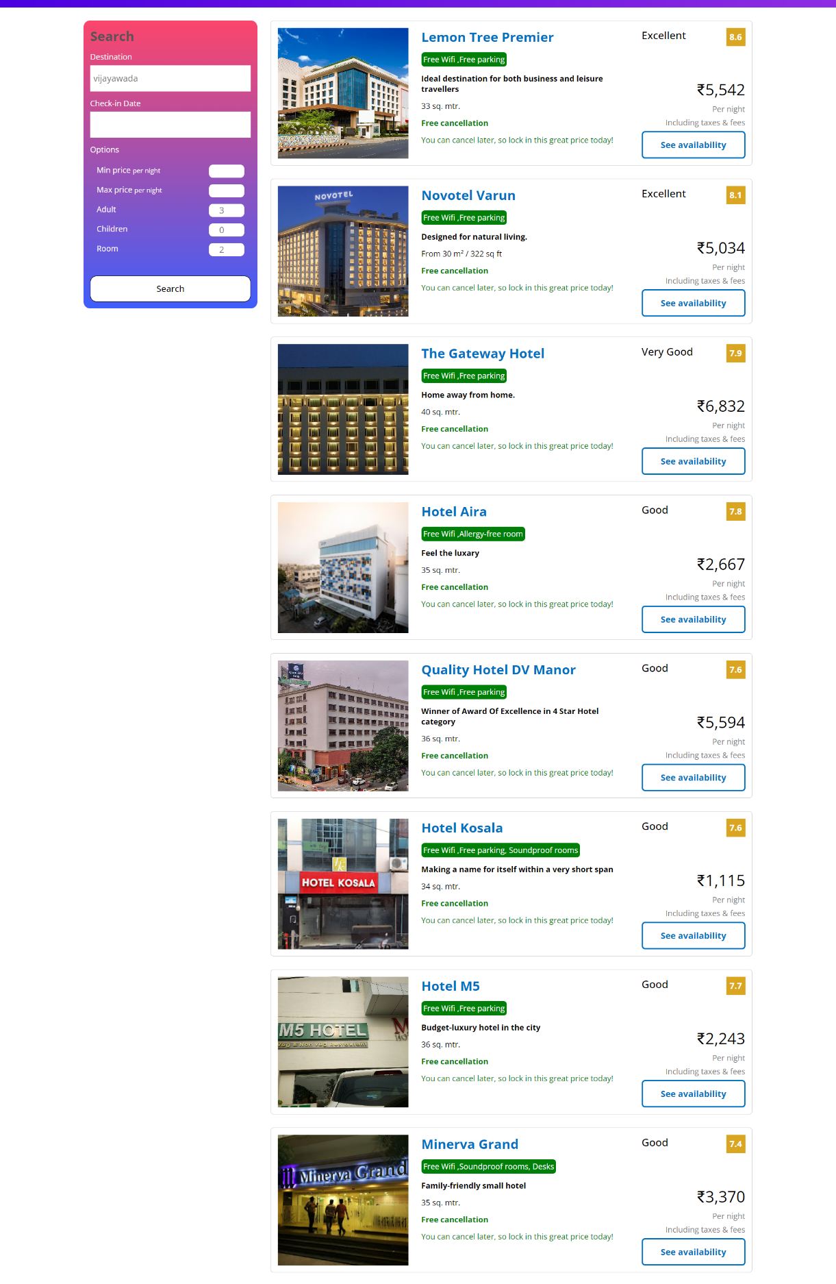
F u l l S c r e e n V I e w

Slide 20
Conclusion
By developing this Hotel website we get to know about features about React Properties Like Props and Hooks like useState, useLocation and useNavigate.
Users can easily book their hotel rooms and can get best experience with user interface and functionalities.
React provides all required Properties and Hooks.

Slide 21
Future Scope
Further more React Components can be added to order to increase App’s Functionality.
We can also include Bootstrap for our React App’s UI.
Many Other Bookings like Flight, Trains etc can be added.
We can Add more payment processors.
Improve Authentication and Authorization.

Slide 22
References
https://www.pluralsight.com/paths/building-web-applications-with-react
https://www.youtube.com/watch?v=LXJOvkVYQqA
https://developers.amadeus.com/blog/react-hotel-booking-app-part2
https://codesandbox.io/s/react-hotel-reservation-site-tutorial-2og6l?from-embed

